Slide 1
My Learning New User Guide
CoE Development & Engagement
http://mylearninghelp.merckgroup.com/
January 2015

Slide 2
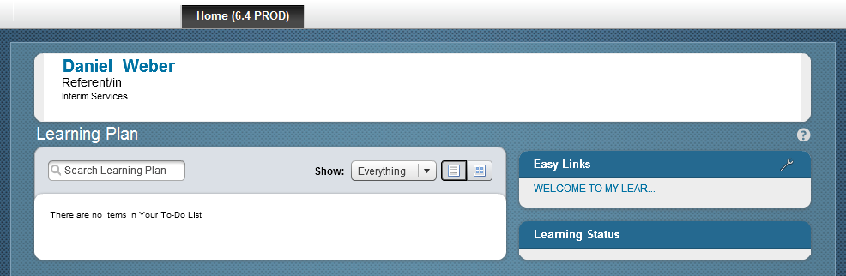
Your first login at My Learning as a new user
When you login to My Learning for the first time you are not yet able to see …
any assigned training on your learning plan
any completed training in your learning history
any of your subordinates (as a manager)
Your My Learning start screen appears like below:
Full access is restricted until “Welcome to My Learning” is complete. This is a Validation requirement.

Slide 3
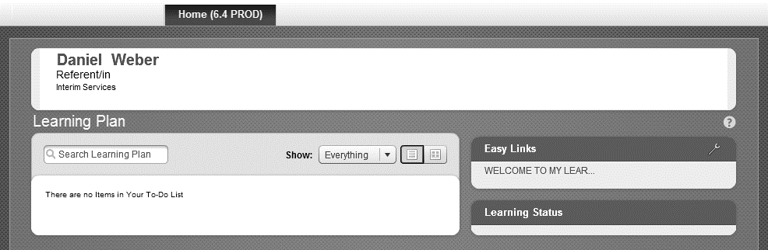
How do I get full learner access in My Learning?
Completion of the “Welcome to My Learning” online training is a prerequisite to get the
full learner access. Please click on the link on My Learning start screen to open the training.
The interactive video takes about 15 minutes.
It will help you to navigate through the My Learning application.

Slide 4
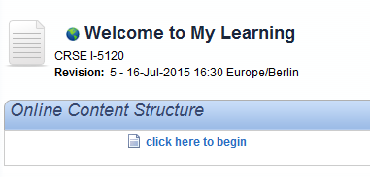
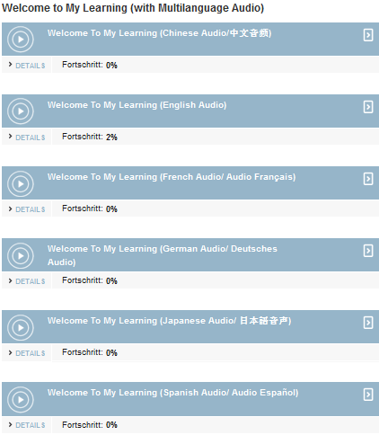
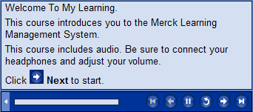
How do I complete “Welcome to My Learning”?
Click here to begin the training video.
Choose the appropriate Audio text language.
Follow the instructions in the navigation bar of the training.

Slide 5

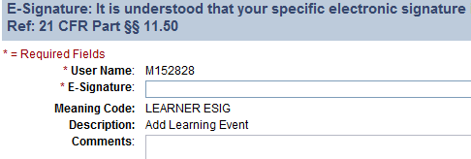
How do I confirm by E-Signature?
Your E-Signature is your personal Windows password.
E-Signature is required in My Learning whenever your personal confirmation/ agreement is required. It is always you Windows password.
Click on ‘Return to Content Structure’ after finish the exam and closing the exam window.
Back in My Learning click on “Return to Content Structure”.
Please confirm with your
e-signature. This is your personal Windows password.

Slide 6
When do I have the full learner access?
The My Learning application needs max. 6 hours to update your profile. The assignment job runs at 12:00am, 06:00am, 12:00pm and 06:00pm everyday.

Slide 7
Congratulations!
You have full learner access
in My Learning!
Where to find general information about My Learning
http://mylearninghelp.merckgroup.com/home
Additional reference materials for new users
http://mylearninghelp.merckgroup.com/new-user
Technical Support
http://gsd.merckgroup.com/en/web/hpsm/support-center-form

